Slide 1
BRIDG Overview and Ballot Results
ISO TC 215
Rio de Janeiro
11 May 2010
Julie Evans
Senior Director, Technical Services, CDISC
Wendy Ver Hoef
Senior Analyst, ScenPro, Inc., Contractor to National Cancer Institute

Slide 2
BRIDG Basics
BRIDG Purpose:
“A collaborative effort to produce a shared view of the dynamic and static semantics that collectively define a shared domain-of-interest in order to achieve computable semantic interoperability in that domain.”
Domain-of-interest (Scope):
“Protocol-driven research and its associated regulatory artifacts, i.e. the data, organization, resources, rules, and processes involved in the formal assessment of the utility, impact, or other pharmacological, physiological, or psychological effects of a drug, procedure, process, subject characteristic, or device on a human, animal, or other subject or substance plus all associated regulatory artifacts required for or derived from this effort, including data specifically associated with post-marketing adverse event reporting. ”
Stakeholders: CDISC, HL7, NCI, FDA
Process:
  Board of Directors prioritizes projects and Semantic Coordination Committee consults with projects and harmonizes project models into main model with help of project analysts/SMEs

Slide 3
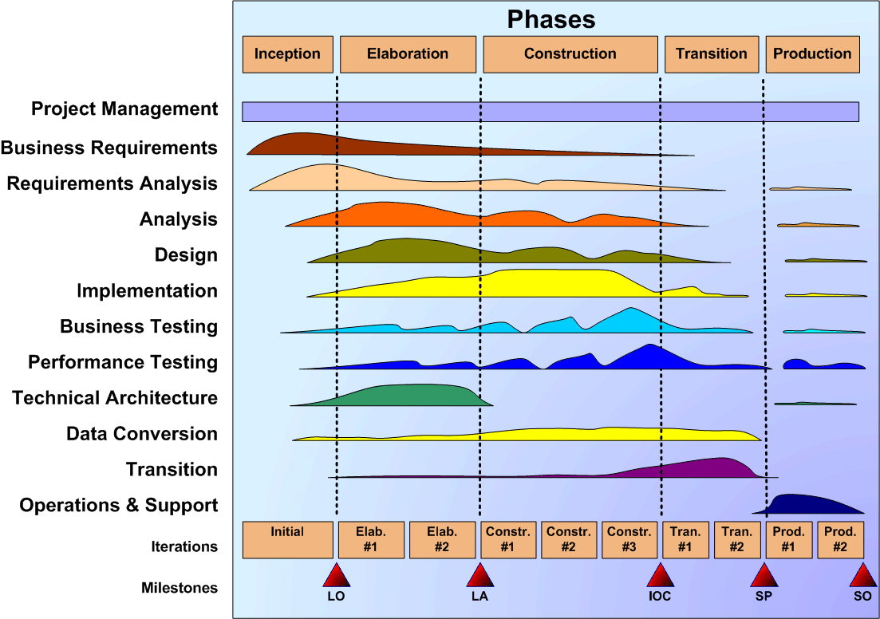
The Unified Process
(Iterative/Incremental, Risk-Focused, Architecture-Centric)
Source: Charlie Mead

Slide 4
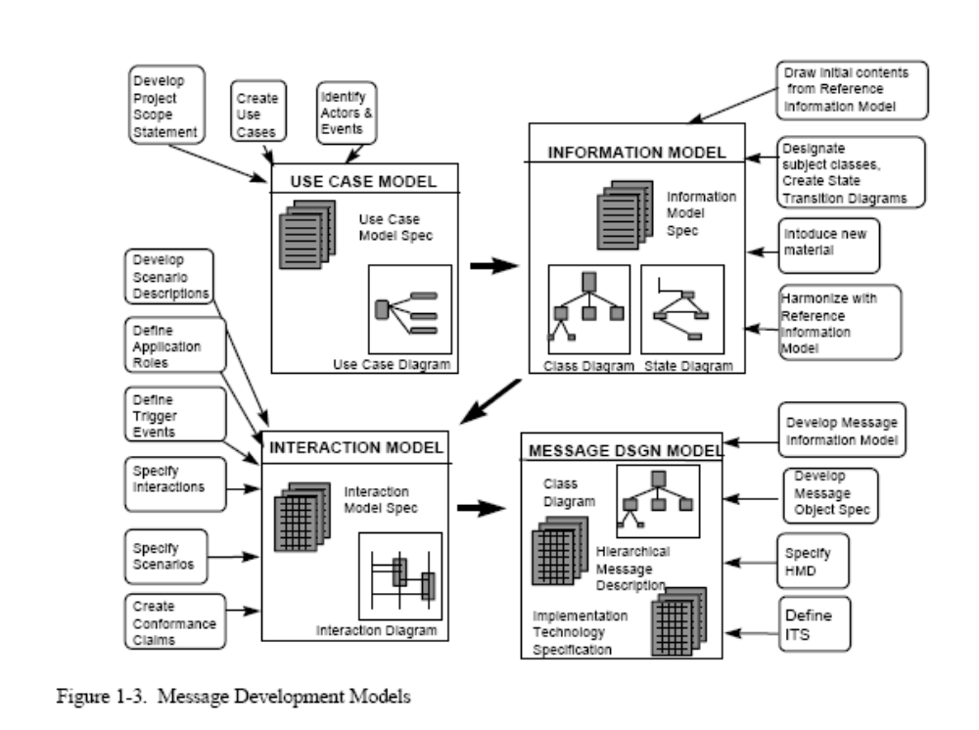
HL7 Development Framework
DAM
RIM

Slide 5
ISO Data Types
Both the BRIDG UML based layer and RIM based layer use ISO data types

Slide 6
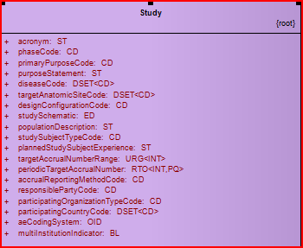
Data Types in BRIDG UML-based Layer
Data type

Slide 7
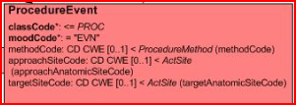
Data Types in BRIDG RIM-based Layer
Datatype

Slide 8
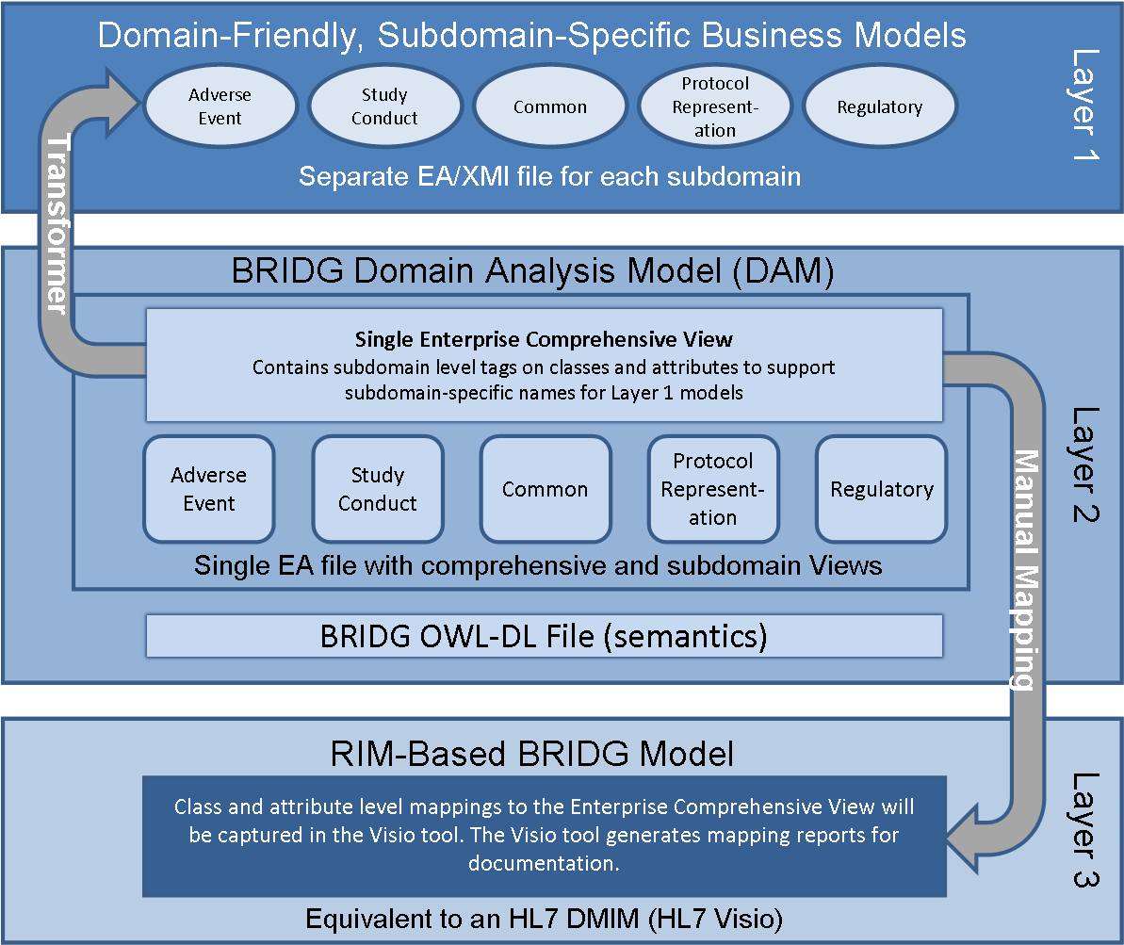
3 Layer Model
Notes:
Talking Points:
Areas covered include but are not limited to: protocols, studies, study sites, organization and org roles, people and people roles, study subjects, study activities (e.g. subject enrollment, specimen collection, lab work, etc.) , products, study design, documents, regulatory artifacts

Slide 9
3 Layer Model
Notes:
Talking Points:
Areas covered include but are not limited to: protocols, studies, study sites, organization and org roles, people and people roles, study subjects, study activities (e.g. subject enrollment, specimen collection, lab work, etc.) , products, study design, documents, regulatory artifacts

Slide 10
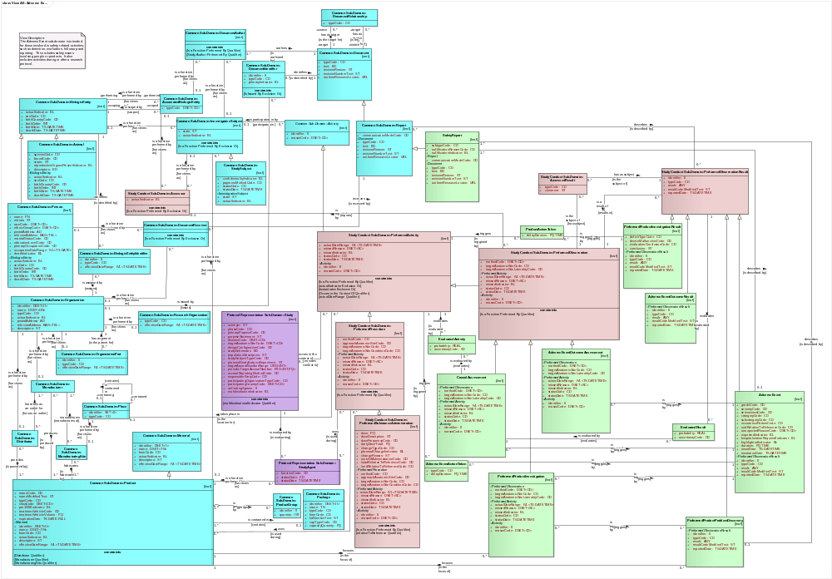
Level 1 Sub-Domain Model: Adverse Events

Slide 11
3 Layer Model
Notes:
Talking Points:
Areas covered include but are not limited to: protocols, studies, study sites, organization and org roles, people and people roles, study subjects, study activities (e.g. subject enrollment, specimen collection, lab work, etc.) , products, study design, documents, regulatory artifacts

Slide 12
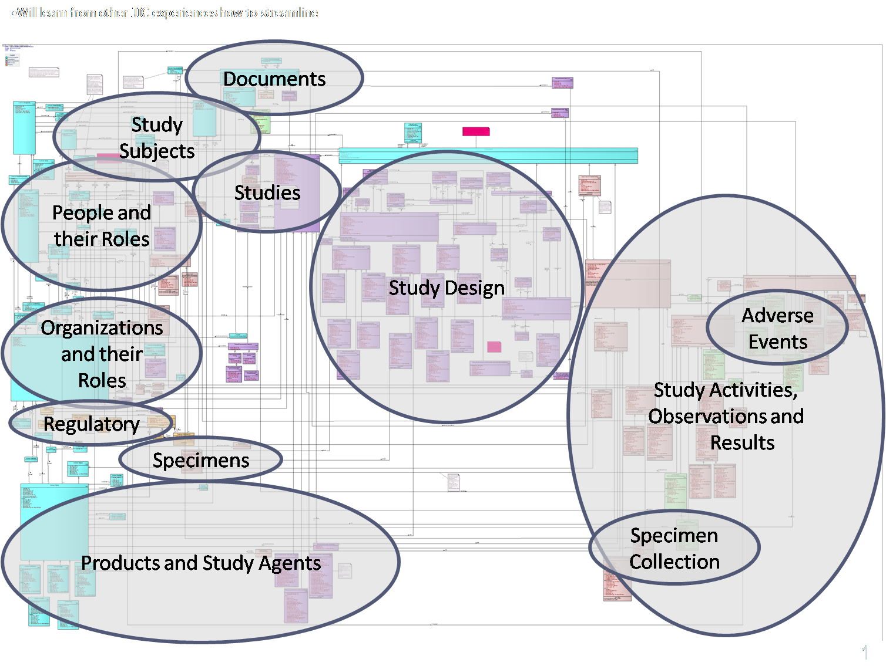
Layer 2: Comprehensive UML Model

Slide 13
3 Layer Model
Notes:
Talking Points:
Areas covered include but are not limited to: protocols, studies, study sites, organization and org roles, people and people roles, study subjects, study activities (e.g. subject enrollment, specimen collection, lab work, etc.) , products, study design, documents, regulatory artifacts

Slide 14
RIM-Based Model
22 separate model diagrams
  2 times the number of attributes in UML-based model
  4-5 times the number of classes in UML-based model
Maps to UML-based model
Uses HL7’s graphical convention (http://www.hl7.org/v3ballot/html/help/v3guide/v3guide.htm#v3dmim)

Slide 15
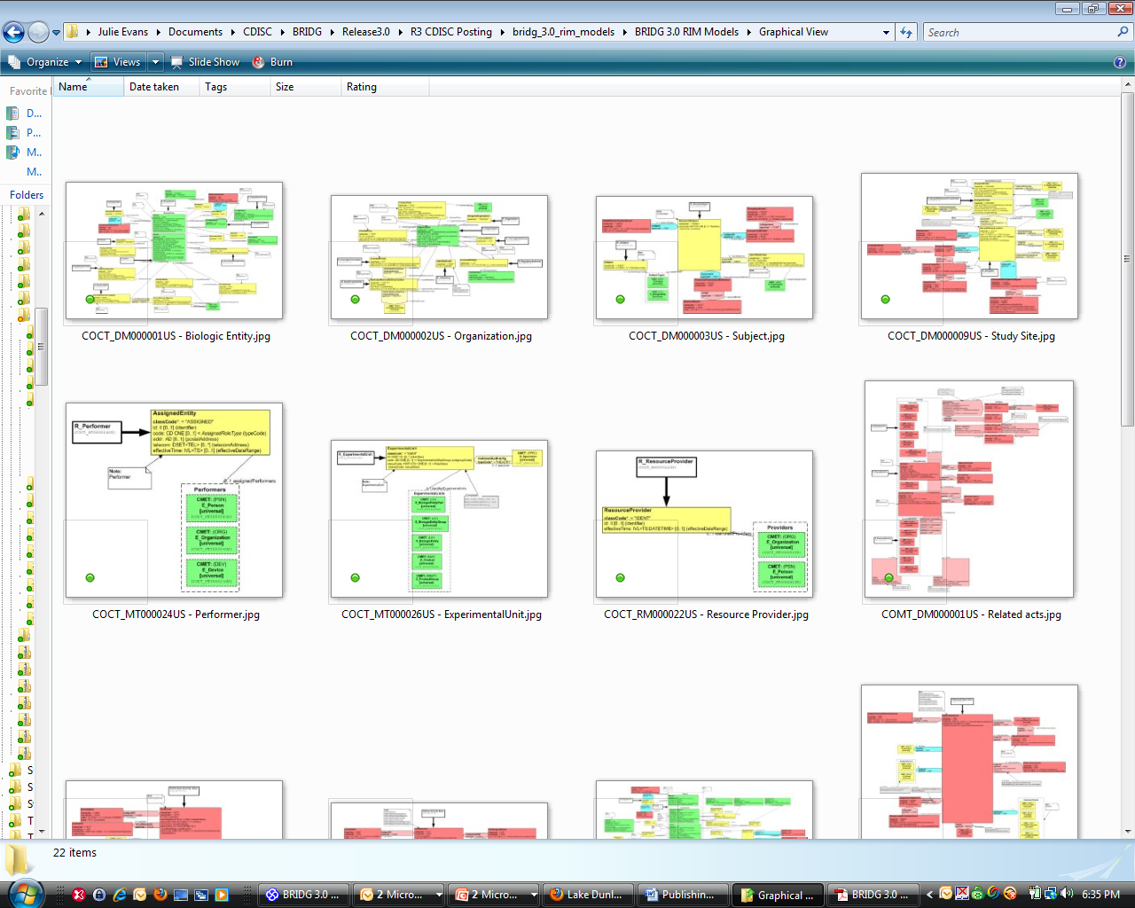
RIM-based Model Diagrams

Slide 16
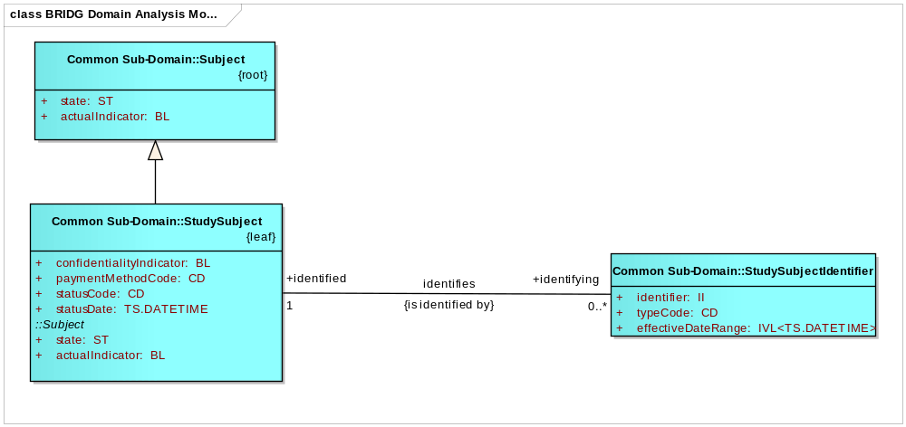
UML-Based Model - Subject

Slide 17
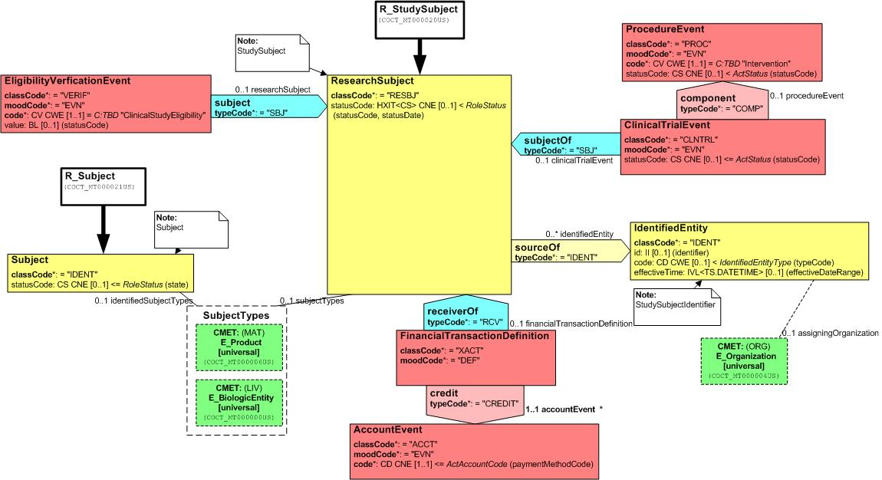
RIM-Based Model - Subject

Slide 18
ISO JIC Process
ISO Ballot - Approved
HL7 Ballot - Approved
CDISC Review and Comment Process – review and comment period completed

Slide 19
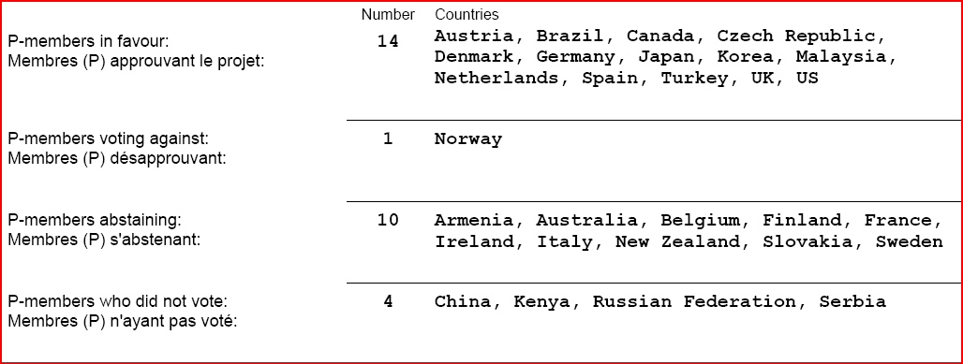
ISO Ballot Results – 4 Comments

Slide 20
HL7 Version 3 Domain Analysis Model: BRIDG, Release 1 (Informative 1) – ~250 Comments
Affirmatives: 46
Negatives: 24
Abstains: 41
No Votes: 28
Total People in Pool: 139
Quorum Level: 79.86%
Affirmatives Needed to Provisionally Pass: 42

Slide 21
CDISC Review and Comment Process
No outstanding comments attributed to CDISC

Slide 22
Plan
Initial triage into categories - Done
Resolve all comments – In progress
Review dispositions with commenters
Update model and documentation
Release ISO DIS and HL7 normative ballot
  Phased to be coterminous

